Slide 1
IBM Data Science Capstone:- Car Accident Severity
(COURSERA)

Slide 2
OBJECTIVE
Main Objectives Of This Project is As Follows
Does whether condition impact accident
Accident measure on the scale of 5
How to Avoid

Slide 3
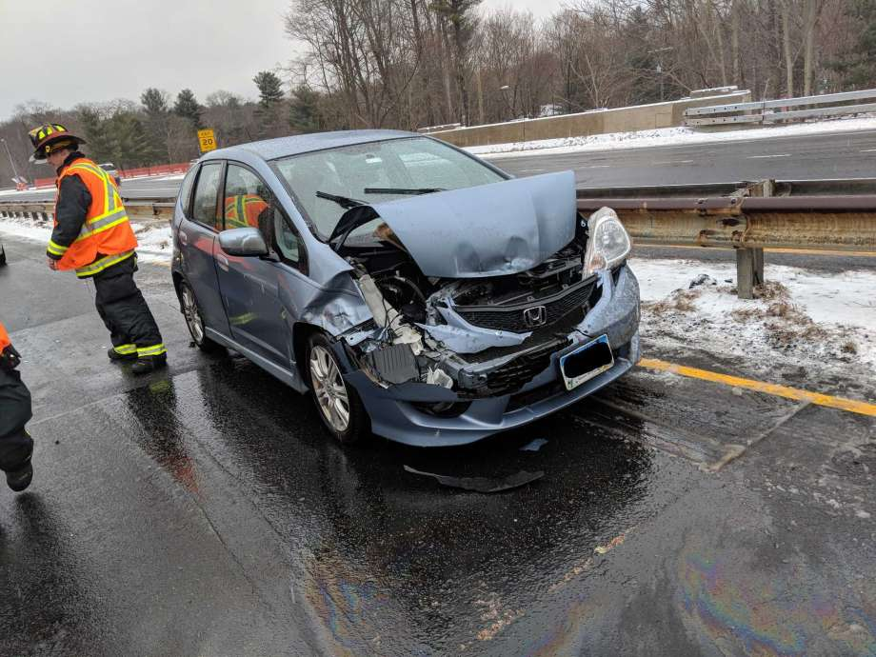
0 – Little to No Probability (Clear Conditions)
1 – Very Low Probability (Chance or Property Damage)
2 – Low Probability (Chance of Injury)
4 – High Probability (Chances of Fatality)
3 – Mild Probability (Chance of Serious Injury)

Slide 4
Machine Models Are As Follows
K-Nearest Neighbor (KNN)
Decision Tree
Logistic Regression

Slide 5
Discussion
In the beginning of this notebook, we had categorical data that was of type 'object'. This is not a data type that we could have fed through an algorithm, so label encoding was used to created new classes that were of type int8; a numerical data type.
After solving that issue we were presented with another - imbalanced data. As mentioned earlier, class 1 was nearly three times larger than class 2. The solution to this was down sampling the majority class with sklearn's resample tool. We down sampled to match the minority class exactly with 58188 values each.
Once we analyzed and cleaned the data, it was then fed through three ML models; K-Nearest Neighbor, Decision Tree and Logistic Regression. Although the first two are ideal for this project, logistic regression made most sense because of its binary nature.
Evaluation metrics used to test the accuracy of our models were jaccard index, f-1 score and log loss for logistic regression. Choosing different k, max depth and hypermeter C values helped to improve our accuracy to be the best possible.

Slide 6
Conclusion and future directions
Based on historical data from weather conditions pointing to certain classes, we can conclude that particular weather conditions have a somewhat impact on whether or not travel could result in property damage (class 1) or injury (class 2).

